Slide 1
Dynamic Dropdowns
20 June 2012
Notes:
Dynamic Dropdowns - <number>
Guidewire training materials contain Guidewire proprietary information that is subject to confidentiality and non-disclosure agreements. You agree to use the information in this manual solely for the purpose of training to implement Guidewire software solutions. You also agree not to disclose the information in this manual to third parties or copy this manual without prior written consent from Guidewire. Guidewire training may be given only by Guidewire employees or certified Guidewire partners under the appropriate agreement with Guidewire.

Slide 2
Lesson objectives
By the end of this lesson, you should be able to:
  Describe the functionality of dynamic dropdowns
  Create dynamic dropdowns
  This lesson uses the notes section for additional explanation and information.
  To view the notes in PowerPoint, choose View→Normal or View→Notes Page.
  If you choose to print the notes for the lesson, be sure to select “Print hidden slides.”
Notes:
Dynamic Dropdowns - <number>

Slide 3
Lesson outline
Dynamic dropdown basics
Array-based dynamic dropdowns
Notes:
Dynamic Dropdowns - <number>

Slide 4
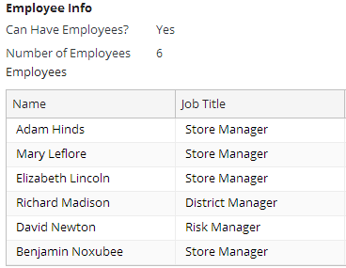
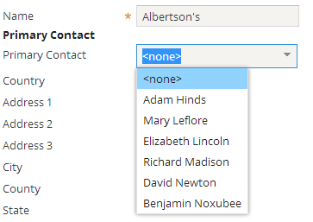
Dynamic dropdowns
A dynamic dropdown is a list of values populated from run-time data (as opposed to typekey data)
Values typically come from an array, but can come from any list (such as a query)
Notes:
Dynamic Dropdowns - <number>
Run-time data is data created during run-time, such as the list of employees for a given company (including perhaps "Adam Hinds", "Mary Leflore", and so on). This is different than typekey data, which is created during implementation, such as the list of phone number types ("work", "home", "mobile", or "fax").

Slide 5
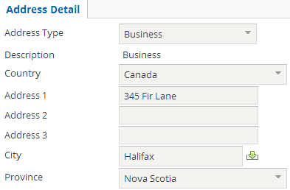
Dynamic vs. dependent dropdowns
Dynamic dropdown
  Possible values set during run-time
  Implemented with object sets and range widgets
  Typically independent of any other single field
Dependent dropdown
  Possible values set during implementation
  Implemented with typecode categories and typekey input widgets
  Paired with another field, typically a "parent dropdown"
Notes:
Dynamic Dropdowns - <number>

Slide 6
Example: Array-based dynamic dropdowns
References array on root object or one of its related objects
  Easier to code than query-based dropdowns
  Can result in better performance than query-based dropdowns
Notes:
Dynamic Dropdowns - <number>

Slide 7
Range widgets
Dynamic dropdowns created using:
  Range input widget (for detail views)
  Range cell widget (for list views)
Range widgets include these properties:
  valueRange - to specify list of values
  value - to store selected value
Notes:
Dynamic Dropdowns - <number>
Range elements are one of the widget types most commonly used for displaying dynamic dropdowns.

Slide 8
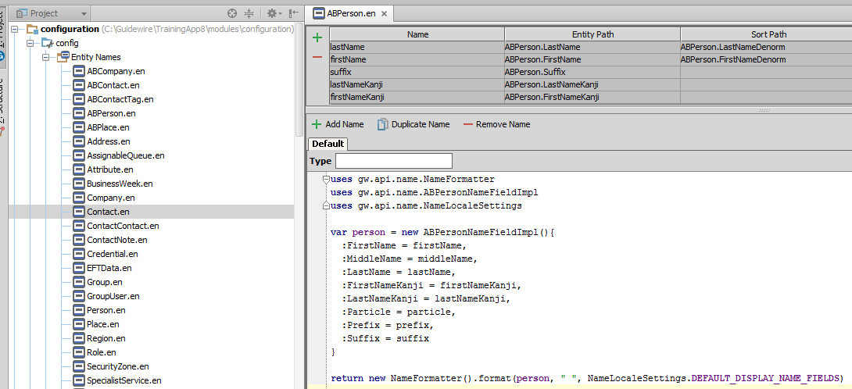
Values displayed in dropdown list
Value displayed is object's DisplayName field
  Configured in Entity Name editor
Notes:
Dynamic Dropdowns - <number>
If a given entity has no entry in the Entity Name editor, then the display value defaults to a concatenated list of column/value pairs, which is typically unacceptable to end users. This typically isn't an issue for entities in each Guidewire base application, as the entities most likely to be displayed have entity names. However, this can be an issue for entities created by developers. If you create a new entity and need to display it in a range widget, it is recommended that you create an entity name for the entity. Entity names are discussed in the "Entity Names" lesson.

Slide 9
Lesson outline
Dynamic dropdown basics
Array-based dynamic dropdowns
Notes:
Dynamic Dropdowns - <number>

Slide 10
Step to create dynamic dropdown
Determine the array to use
Create the range widget
Specify the range widget's properties
Notes:
Dynamic Dropdowns - <number>

Slide 11
Array example: Primary Contact dropdown
ABCompany entity has PrimaryContact field, which points to employee of given ABCompany
  Dropdown uses array that already exists on ABCompany
Notes:
Dynamic Dropdowns - <number>

Slide 12
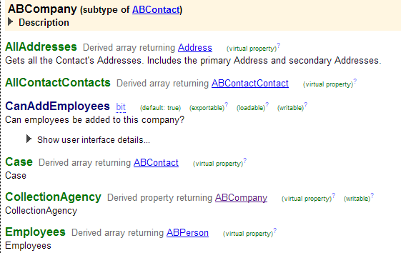
Step 1: Determine the array to use
Notes:
Dynamic Dropdowns - <number>

Slide 13
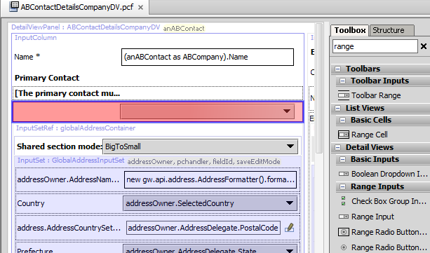
Step 2: Add range widget
Because widget is added to detail view, range input is used (as opposed to range cell)
Notes:
Dynamic Dropdowns - <number>

Slide 14
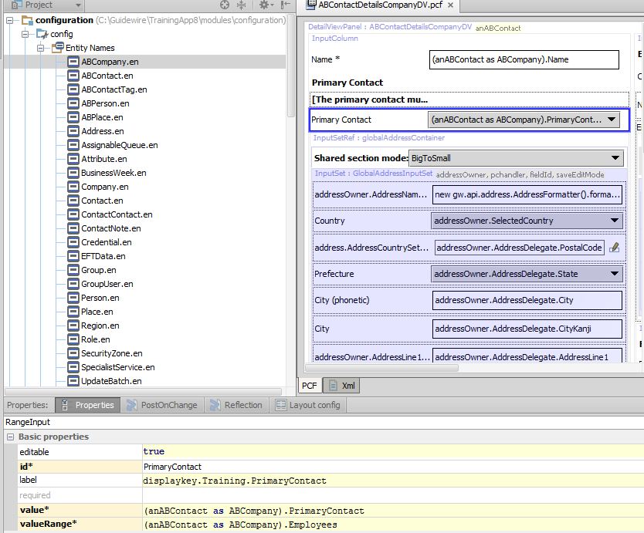
Step 3: Specify widget properties
Notes:
Dynamic Dropdowns - <number>
In the example above, the root object is anABContact, which is an ABContact. However, the Employees array exists only at the ABCompany subtype level. Therefore, the valueRange is stated not as "anABContact.Employees" (which would not compile because there is no Employees array at the ABCompany level), but rather "(anABContact as ABCompany).Employees" (which casts the ABContact object as an ABCompany and identifies to the application the subtype level at which the desired Employee array can be found).

Slide 15
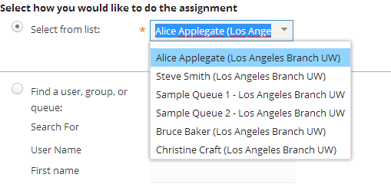
Dynamic dropdowns are not limited to arrays
Value range can be set to any list object, such as a database query
  This type of implementation is less common, but technically possible
User
Coverage
Notes:
Dynamic Dropdowns - <number>
The Assigned User dropdown shown above queries the user table for all users who have the "contact manager" role. This example is a reasonable implementation for a practice application such as TrainingApp, but might be impractical for a real Guidewire application where the query for the users might compromise the application's performance.

Slide 16
Lesson objectives review
You should now be able to:
  Describe the functionality of dynamic dropdowns
  Create dynamic dropdowns
Notes:
Dynamic Dropdowns - <number>

Slide 17
Review questions
Assume you have a Product entity, and a list of Product objects appear in a dynamic dropdown. What field on Product is used as the display value in the dropdown list?
When would you implement a dynamic dropdown using a range input (as opposed to a range cell)?
Notes:
Dynamic Dropdowns - <number>
Answers
1. Product.DisplayName (Range widgets always display the objects' DisplayName field).
2. You would use a range input when adding a dynamic dropdown to a detail view; range cells are used for adding dynamic dropdowns to list views.

Slide 18
Notices
Copyright © 2001-2013 Guidewire Software, Inc. All rights reserved.
Guidewire, Guidewire Software, Guidewire ClaimCenter, Guidewire PolicyCenter, Guidewire BillingCenter, Guidewire Reinsurance Management, Guidewire ContactManager, Guidewire Vendor Data Management, Guidewire Client Data Management, Guidewire Rating Management, Guidewire InsuranceSuite, Guidewire ContactCenter, Guidewire Studio, Guidewire Product Designer, Guidewire Live, Guidewire DataHub, Guidewire InfoCenter, Guidewire Standard Reporting, Guidewire ExampleCenter, Gosu, Deliver Insurance Your Way, and the Guidewire logo are trademarks, service marks, or registered trademarks of Guidewire Software, Inc. in the United States and/or other countries.
Guidewire products are protected by one or more United States patents.
Notes:
Notices - <number>

